Slide 1




Write Antifragile & Domain-Driven Tests with
QA
Smoke tests Exploratory tests End-to-end tests
Outside-in diamond TDD
contract tests
Integration tests
Acceptance tests
(Coarse-grained “unit” tests)
Thomas PIERRAIN @tpierrain (υѕe caѕe drιven)
unit tests
(Fine-grained)
THOMAS PIERRAIN (@TPIERRAIN)
Notes:
Yo
(dynamic) Hello everyone! (pause, then slowly) Test, it’s one of my fav topic ever. It’s been a while since I started to TDD (more than 15 years now). I’ve made almost every mistake one can imagine with it: violating encapsulation in order to test private members (don’t do that; -), implement Fragile tests (because we’ve made tests towards implementation details. Don’t do that ;-), duplicate production code logic in test (don’t do that), making less baby steps than one should (don’t do that ), write too much complex tests and setups (don’t do that either), etc.
I’ve talked about TDD in conferences, I live coded publicly, I wrote some press articles, blog post but I think that it’s time now for me to talk about something that I’ve discovered like 4 years ago or more, and that gave me lots of efficiency and lot of joy at work with the various dev teams I worked with. Better than that, which is scalable within dev teams.
This is a way of doing TDD (both a workflow and some important characteristics). With my associate Bruno Boucard we called it Outside-in Diamond TDD. It allow us to write anti-fragile and Domain-Driven tests.
But before we dive into the topic, let me introduce myself:
My name is Thomas PIERRAIN, I’ve been building software for more than 23 years now. Doing pretty much all the job one can find in IT (and even more): dev, tech-lead, project manager, software architect, enterprise architect, coach, big brother… but alway continued to code aside (even when I was involved with comex and more organizational topics) including open source projects. All in .NET, and almost all related to testing: testing fluent assertions with Nfluent, Fuzzers with Diverse, Smoke tests with SmokeMe and some other libraries related to DDD like Value (to easily implement value types in .NET).
I worked in many domains like games, finance, health care, music and now in the hospitality industry since almost 2 years.
I split my weeks by managing an API dev team for an international group in Hospitality, and do some DDD and architecture consulting and training for other clients.
Last but not least, I’m practicing DDD since more than 10 years and I’m Co-organizer of the DDD meetup in France: DDD FR (you can check the videos of our community on yt, there are some really interesting things)
On va live coder !
Ok!

Slide 2
Disclaimers
There is no silver bullet Your testing strategy & techniques must always be chosen accordingly to your context (both human & technical)
As long as you understand your trade-offs there is no reason not to explore new paths…
Thanks to Kent Beck, Martin Fowler, Michael Feathers, Nat Pryce & Steve Freeman for their great source of inspiration over the years #shouldersOfGiants
Notes:
I want to make a few disclaimers here. Because it’s important:
After more than 15 years of TDD practice, we are describing here a testing strategy (outside-in diamond) that works amazingly well in many of our contexts (clients, domains , teams, cultures)

Slide 3
Preamble

Slide 4


DDD loves…
E-commerce
BFF API
d
d
Booking API
CMS API
d
U
d
U
Payment
Marketing
U
Accounts API
PSP API
Central Reservation
Loyalty API
U
CRS API
(Contextualized)
Services
U
Stay
d
d
Revenue Mgmt
d
U
Property Management System (PMS)
U
Rates & Cancellation rules API
Distribution
THOMAS PIERRAIN (@TPIERRAIN)
Resorts
Referential
Metasearch API
d
U
Hospitality
Notes:
Image : https://insights-images.thoughtworks.com/pairprogramming_f0d3ae7ef121e981e150bfcae4ecb995.jpg

Slide 5
DDD loves…
E-commerce
BFF API
d
d
Booking API
CMS API
d
U
d
U
Payment
Marketing
U
Accounts API
PSP API
Central Reservation
Loyalty API
U
CRS API
(Contextualized)
Services
U
Stay
d
d
Revenue Mgmt
d
U
Property Management System (PMS)
U
Rates & Cancellation rules API
Distribution
THOMAS PIERRAIN (@TPIERRAIN)
Resorts
Referential
Metasearch API
d
U
Hospitality
Notes:
Image : https://insights-images.thoughtworks.com/pairprogramming_f0d3ae7ef121e981e150bfcae4ecb995.jpg

Slide 6
DDD (& TDD) also loveS…
Our WeB API
HTTP
Infrastructure
Adapter
Domain
Ports & Adapters
Adapter
THOMAS PIERRAIN (@TPIERRAIN)
HTTP
API
Notes:
Image : https://insights-images.thoughtworks.com/pairprogramming_f0d3ae7ef121e981e150bfcae4ecb995.jpg

Slide 7
DDD (& TDD) also love…
Our WeB API
HTTP
Infrastructure
Easy to test
Protect Domain code from Infra fads
Quick feedback (carpaccio-style slicing)
Allow late
architectural decisions
Composable: modular-monolith ready
Adapter
Domain
Ports & Adapters
Adapter
THOMAS PIERRAIN (@TPIERRAIN)
HTTP
API
Notes:
Image : https://insights-images.thoughtworks.com/pairprogramming_f0d3ae7ef121e981e150bfcae4ecb995.jpg

Slide 8
DDD (& TDD) also love…
Domain First
Infrastructure
Adapter
Adapter
Domain
Ports & Adapters
Adapter
Adapter
THOMAS PIERRAIN (@TPIERRAIN)
Notes:
Image : https://insights-images.thoughtworks.com/pairprogramming_f0d3ae7ef121e981e150bfcae4ecb995.jpg

Slide 9
DDD (& TDD) also love…
Deploy as you wish
Our WeB API
HTTP
Infrastructure
Adapter
Domain
Ports & Adapters
Adapter
THOMAS PIERRAIN (@TPIERRAIN)
HTTP
API
Notes:
Image : https://insights-images.thoughtworks.com/pairprogramming_f0d3ae7ef121e981e150bfcae4ecb995.jpg

Slide 10
Let’s talk about tests!

Slide 11


A world of Tests
ET
Exploratory Tests (E2E)
IT
Integration Tests (Contract)
Different Types
AT
(coarse-grained unit) Acceptance Tests
THOMAS PIERRAIN (@TPIERRAIN)
UT
(fine-grained) Unit Tests

Slide 12
Why do I do TDD?

Slide 13
Made me…
Test Driven
development
Baby steps eradicate Procrastination and premature optimizations
Less debugging with Live testing tools
No regression
More relaxed
More efficient
More relevant
THOMAS PIERRAIN (@TPIERRAIN)
YAGNI ( Outside-in form )
Shared and clarified mental models
Notes:
Premature optimization: Split the make it work and the make it better
YAGNI: focus only on what really matter.
More relaxed – Against Procrastination and premature optimizations
More efficient – Progressive consolidation with baby steps
More relevant – Outside-in embraces YAGNI
Image: https://miro.medium.com/max/13440/1*o7WmwGkLVR0dVQUYqfSBeg.jpeg

Slide 14
TDD Workflows

Slide 15
Outside-in
Test Driven
development
THOMAS PIERRAIN (@TPIERRAIN)
Notes:
Image: https://miro.medium.com/max/13440/1*o7WmwGkLVR0dVQUYqfSBeg.jpeg

Slide 16
Outside-in
Test Driven
development
AT
THOMAS PIERRAIN (@TPIERRAIN)
Notes:
Image: https://miro.medium.com/max/13440/1*o7WmwGkLVR0dVQUYqfSBeg.jpeg

Slide 17
Outside-in
Test Driven
development
AT
THOMAS PIERRAIN (@TPIERRAIN)
Notes:
Image: https://miro.medium.com/max/13440/1*o7WmwGkLVR0dVQUYqfSBeg.jpeg

Slide 18
Outside-in
Test Driven
development
AT
AT
THOMAS PIERRAIN (@TPIERRAIN)
Notes:
Image: https://miro.medium.com/max/13440/1*o7WmwGkLVR0dVQUYqfSBeg.jpeg

Slide 19
Outside-in
Test Driven
development
AT
AT
AT
THOMAS PIERRAIN (@TPIERRAIN)
Notes:
Image: https://miro.medium.com/max/13440/1*o7WmwGkLVR0dVQUYqfSBeg.jpeg

Slide 20
Outside-in
Test Driven
development
AT
AT
AT
AT
THOMAS PIERRAIN (@TPIERRAIN)
Notes:
Image: https://miro.medium.com/max/13440/1*o7WmwGkLVR0dVQUYqfSBeg.jpeg

Slide 21
Outside-in
Test Driven
development
AT
AT
AT
AT
AT
THOMAS PIERRAIN (@TPIERRAIN)
Notes:
Image: https://miro.medium.com/max/13440/1*o7WmwGkLVR0dVQUYqfSBeg.jpeg

Slide 22
Outside-in
Test Driven
development
AT
AT
AT
AT
AT
AT
THOMAS PIERRAIN (@TPIERRAIN)
Notes:
Image: https://miro.medium.com/max/13440/1*o7WmwGkLVR0dVQUYqfSBeg.jpeg

Slide 23
Outside-in
Test Driven
development
AT
AT
AT
AT
AT
AT
AT
THOMAS PIERRAIN (@TPIERRAIN)
Notes:
Image: https://miro.medium.com/max/13440/1*o7WmwGkLVR0dVQUYqfSBeg.jpeg

Slide 24
Inside-out
Test Driven
development
THOMAS PIERRAIN (@TPIERRAIN)
Notes:
Image: https://miro.medium.com/max/13440/1*o7WmwGkLVR0dVQUYqfSBeg.jpeg

Slide 25
Inside-out
Test Driven
development
UT
THOMAS PIERRAIN (@TPIERRAIN)
Notes:
Image: https://miro.medium.com/max/13440/1*o7WmwGkLVR0dVQUYqfSBeg.jpeg

Slide 26
Inside-out
Test Driven
development
UT
UT
API
THOMAS PIERRAIN (@TPIERRAIN)
Notes:
Image: https://miro.medium.com/max/13440/1*o7WmwGkLVR0dVQUYqfSBeg.jpeg

Slide 27
Inside-out
Test Driven
development
UT
UT
API
UT
THOMAS PIERRAIN (@TPIERRAIN)
Notes:
Image: https://miro.medium.com/max/13440/1*o7WmwGkLVR0dVQUYqfSBeg.jpeg

Slide 28
Inside-out
Test Driven
development
UT
UT
API
UT
THOMAS PIERRAIN (@TPIERRAIN)
UT
Notes:
Image: https://miro.medium.com/max/13440/1*o7WmwGkLVR0dVQUYqfSBeg.jpeg

Slide 29
Inside-out
Test Driven
development
UT
UT
API
UT
UT
THOMAS PIERRAIN (@TPIERRAIN)
UT
Notes:
Image: https://miro.medium.com/max/13440/1*o7WmwGkLVR0dVQUYqfSBeg.jpeg

Slide 30
Inside-out
Test Driven
development
UT
UT
API
UT
UT
THOMAS PIERRAIN (@TPIERRAIN)
UT
UT
Notes:
Image: https://miro.medium.com/max/13440/1*o7WmwGkLVR0dVQUYqfSBeg.jpeg

Slide 31
Inside-out
Test Driven
development
UT
UT
API
UT
UT
THOMAS PIERRAIN (@TPIERRAIN)
UT
UT
UT
Notes:
Image: https://miro.medium.com/max/13440/1*o7WmwGkLVR0dVQUYqfSBeg.jpeg

Slide 32
Inside-out
Test Driven
development
UT
UT
AT
API
UT
UT
THOMAS PIERRAIN (@TPIERRAIN)
UT
UT
UT
Notes:
Image: https://miro.medium.com/max/13440/1*o7WmwGkLVR0dVQUYqfSBeg.jpeg

Slide 33
Inside-out
Test Driven
development
AT
UT
UT
AT
API
UT
UT
THOMAS PIERRAIN (@TPIERRAIN)
UT
UT
UT
Notes:
Image: https://miro.medium.com/max/13440/1*o7WmwGkLVR0dVQUYqfSBeg.jpeg

Slide 34
Workflows
Test Driven
development
API
…
API
…
Outside-in
Inside-out
THOMAS PIERRAIN (@TPIERRAIN)
Notes:
Image: https://miro.medium.com/max/13440/1*o7WmwGkLVR0dVQUYqfSBeg.jpeg

Slide 35
Common pitfalls & mitigations

Slide 36

Test Driven
development
When we test Implementations instead of behaviours ; - (
Because We tend to overlook some boring but crucial areas ( like adapters code )
1. Fragile tests
2. Blind spots
3. Complex setups
When ( Unit x Integration )
Test coverage is not enough
Beware of…
THOMAS PIERRAIN (@TPIERRAIN)
cognitive overload reduces stamina
and engagement
Notes:
Cognitive overload reduce stamina ➔ Pit of failure. Like a broken window syndrome.
https://www.welcometothejungle.com/en/articles/cognitive-overload-at-work
Image : https://encrypted-tbn0.gstatic.com/images?q=tbn:ANd9GcRUkEI7a62LZWV7URYcN5jClByl0GkP6ReZvA&usqp=CAU
I could have added
Non deterministic
The team must be confident in their tests
Fragile tests / Painful Refactoring
Messy test code
Slowness
Non deterministic

Slide 37
Test Driven
development
API
uses
uses
1.
Beware of… Fragile tests

Slide 38
Test Driven
development
AT
AT
UT
API
UT
uses
UT
1.
Beware of… Fragile tests
UT
THOMAS PIERRAIN (@TPIERRAIN)
UT
UT

Slide 39
Test Driven
development
AT
AT
UT
API
Now we want to change our implementation here
UT
uses
UT
1.
Beware of… Fragile tests
UT
THOMAS PIERRAIN (@TPIERRAIN)
UT
UT

Slide 40
Test Driven
development
AT
AT
UT
API
UT
uses
UT
1.
Beware of… Fragile tests
UT
THOMAS PIERRAIN (@TPIERRAIN)
UT
UT

Slide 41
Test Driven
development
AT
AT
UT
😕
API
UT
😕
uses
UT
1.
Beware of… Fragile tests
😕
UT
😕
😕
😕
THOMAS PIERRAIN (@TPIERRAIN)
UT
UT

Slide 42
Test Driven
development
AT
AT
UT
😕
API
UT
😕
uses
UT
Fragile tests
➔ Less refactoring
UT
😕
😕
😕
😕
THOMAS PIERRAIN (@TPIERRAIN)
UT
UT

Slide 43
Test Driven
development
AT
AT
UT
😕
Mitigations
Do not test “implementations”
Focus on external behaviours instead (with Outside-in TDD)
Favor (coarse-grained unit) Acceptance tests over fine-grained unit tests
API
UT
😕
uses
UT
Fragile tests
AP
…
…
UT
😕
😕
😕
THOMAS PIERRAIN (@TPIERRAIN)
UT
UT

Slide 44
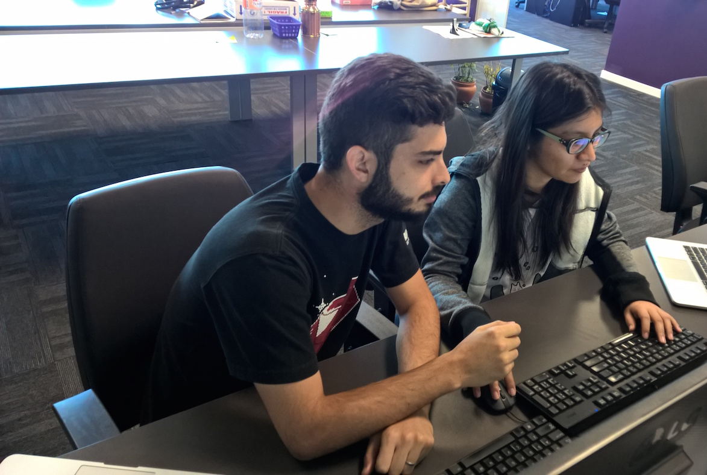
Test Driven
development
Disclaimer
Test Coverage will be a visual help to identify blind spots in our code here
It doesn’t mean that test coverage is a must
2.
Beware of… Blind Spots
THOMAS PIERRAIN (@TPIERRAIN)
Notes:
Image : https://insights-images.thoughtworks.com/pairprogramming_f0d3ae7ef121e981e150bfcae4ecb995.jpg

Slide 45
Test Driven
development
Our WeB API
HTTP
Infrastructure
Adapter
Domain
2.
Beware of… Blind Spots
Adapter
HTTP
API
THOMAS PIERRAIN (@TPIERRAIN)
Notes:
Image : https://insights-images.thoughtworks.com/pairprogramming_f0d3ae7ef121e981e150bfcae4ecb995.jpg

Slide 46
Test Driven
development
Test the domain code with { acceptance | unit tests }
Domain
2.
Beware of… Blind Spots
THOMAS PIERRAIN (@TPIERRAIN)
Notes:
Image : https://insights-images.thoughtworks.com/pairprogramming_f0d3ae7ef121e981e150bfcae4ecb995.jpg

Slide 47
Test Driven
development
Test the domain code with { acceptance | unit tests }
Adapter
Domain
2.
Beware of… Blind Spots
Adapter
HTTP
Test the infra code (i.e. Adapters) with contract (integration) tests
API
THOMAS PIERRAIN (@TPIERRAIN)
Notes:
Image : https://insights-images.thoughtworks.com/pairprogramming_f0d3ae7ef121e981e150bfcae4ecb995.jpg

Slide 48
Test Driven
development
AT
AT
AT
AT
AT
AT
AT
AT
AT
AT
AT
AT
Domain
AT
AT
AT
100% covered
by Acceptance Tests
Stub
HTTP
2.
Beware of… Blind Spots
API
Right Adapter
80%
IT
IT
IT
⬄
IT
THOMAS PIERRAIN (@TPIERRAIN)
Contract tests
Stub
Notes:
Image : https://insights-images.thoughtworks.com/pairprogramming_f0d3ae7ef121e981e150bfcae4ecb995.jpg

Slide 49

Test Driven
development
As DEV we
to write Domain-Driven tests
AT
AT
AT
AT
AT
AT
AT
AT
AT
AT
AT
AT
Domain
AT
AT
AT
100% covered
by Acceptance Tests
Stub
HTTP
2.
Beware of… Blind Spots
API
Right Adapter
80%
IT
IT
IT
⬄
IT
THOMAS PIERRAIN (@TPIERRAIN)
Contract tests
Stub
Notes:
Image : https://insights-images.thoughtworks.com/pairprogramming_f0d3ae7ef121e981e150bfcae4ecb995.jpg

Slide 50

Test Driven
development
As DEV we
to write Domain-Driven tests
AT
AT
AT
AT
AT
AT
AT
AT
AT
AT
AT
AT
Domain
AT
AT
AT
100% covered
by Acceptance Tests
Stub
HTTP
2.
Beware of… Blind Spots
API
Right Adapter
80%
BUG
BUG
IT
IT
IT
⬄
IT
THOMAS PIERRAIN (@TPIERRAIN)
Contract tests
Stub
Notes:
Image : https://insights-images.thoughtworks.com/pairprogramming_f0d3ae7ef121e981e150bfcae4ecb995.jpg

Slide 51
Test Driven
development
As DEV we
to write Domain-Driven tests
AT
AT
AT
AT
AT
AT
AT
AT
AT
AT
AT
AT
Domain
AT
AT
AT
100% covered
by Acceptance Tests
Stub
HTTP
2.
Beware of… Blind Spots
API
As DEV we don’t write enough integration tests
Because they are slow to run & boring
➔
Right Adapter
80%
BUG
BUG
IT
IT
IT
⬄
IT
THOMAS PIERRAIN (@TPIERRAIN)
Contract tests
BUGS
Stub
Notes:
Image : https://insights-images.thoughtworks.com/pairprogramming_f0d3ae7ef121e981e150bfcae4ecb995.jpg

Slide 52
Test Driven
development
As DEV we
to write Domain-Driven tests
AT
AT
AT
AT
AT
AT
AT
AT
AT
AT
AT
AT
Domain
AT
AT
AT
Mitigations
Detect bugs in Adapters via our beloved Acceptance tests
Include the Adapters code and stub only the I/Os
100% covered
by Acceptance Tests
BUGS
Stub
HTTP
Blind Spots
API
As DEV we don’t write enough integration tests
Because they are slow to run & boring
➔
Right Adapter
80%
BUG
BUG
IT
IT
IT
⬄
IT
THOMAS PIERRAIN (@TPIERRAIN)
Contract tests
BUGS
Stub
Notes:
Image : https://insights-images.thoughtworks.com/pairprogramming_f0d3ae7ef121e981e150bfcae4ecb995.jpg

Slide 53
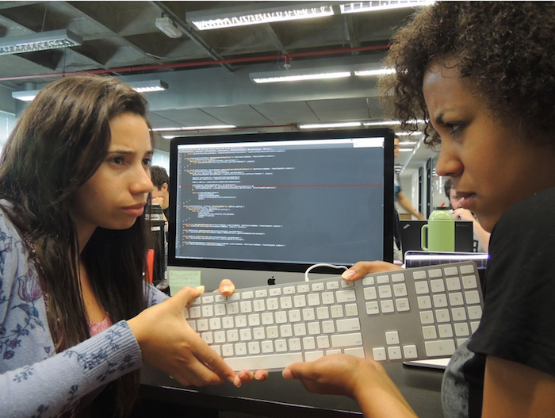
Test Driven
development
3.
Beware of… Complex setups
THOMAS PIERRAIN (@TPIERRAIN)
Notes:
Image: https://insights-images.thoughtworks.com/1020ways20pair20programming201_ac7561ab53c005c72dd42a76dcc238a9.png

Slide 54
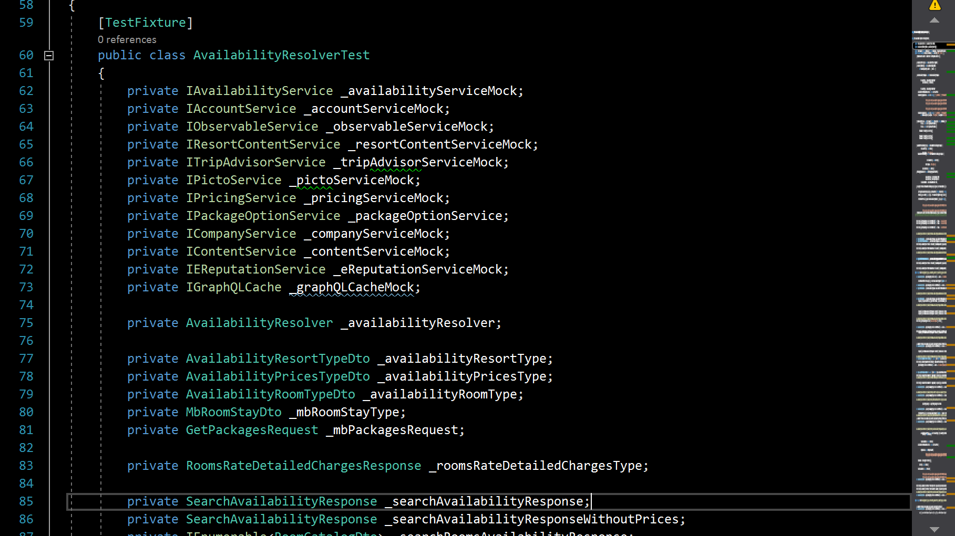
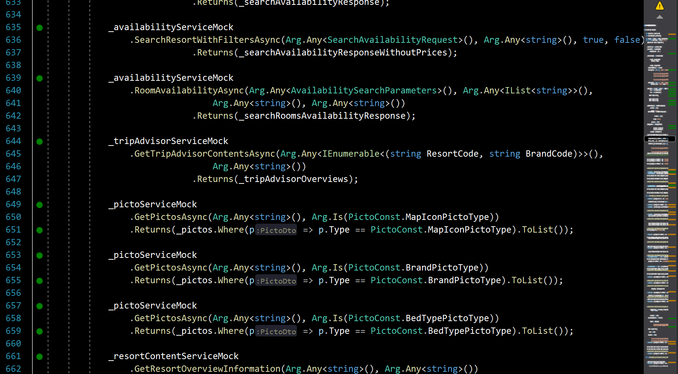
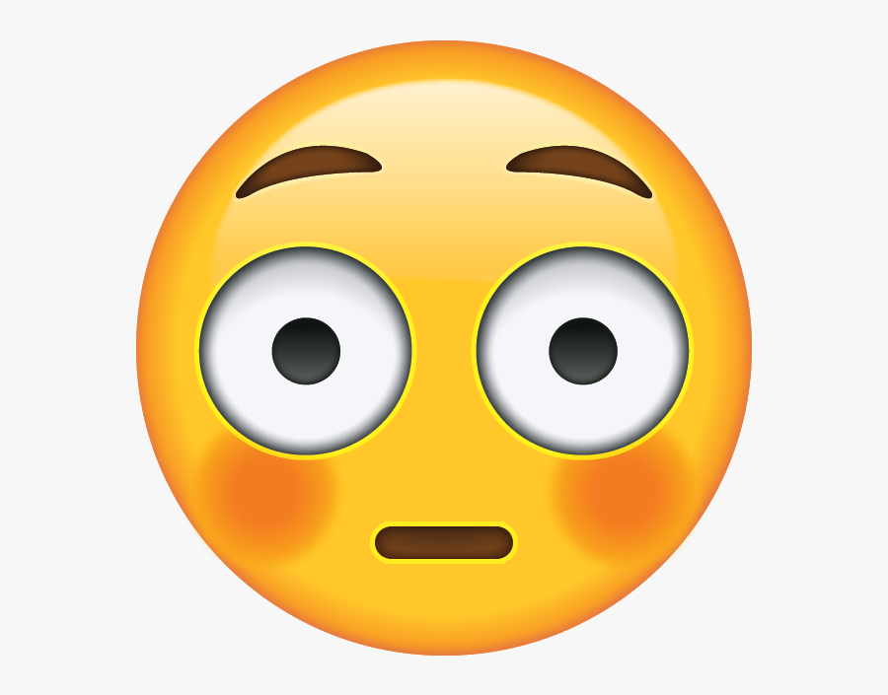
Test Driven
development
Test Suite for Rooms Availability
740 lines of Init()
3.
Beware of… Complex setups
THOMAS PIERRAIN (@TPIERRAIN)
Notes:
Image: https://insights-images.thoughtworks.com/1020ways20pair20programming201_ac7561ab53c005c72dd42a76dcc238a9.png

Slide 55
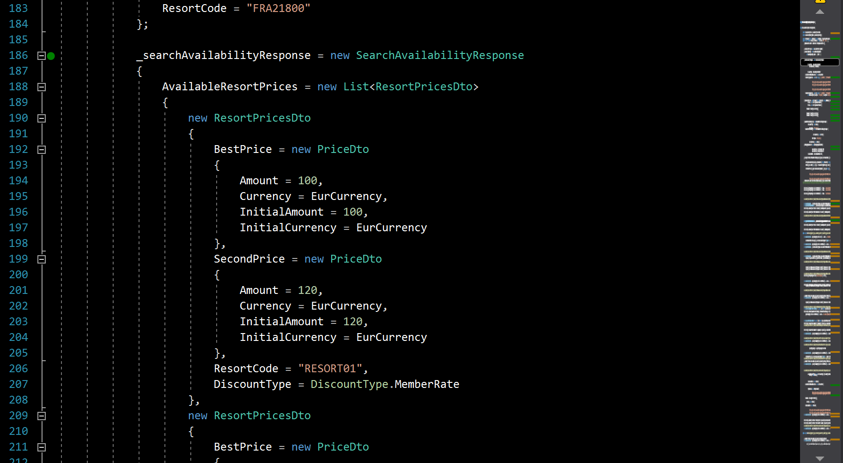
Test Driven
development
Test Suite for Rooms Availability
740 lines of Init()
3.
Beware of… Complex setups
THOMAS PIERRAIN (@TPIERRAIN)
Notes:
Image: https://insights-images.thoughtworks.com/1020ways20pair20programming201_ac7561ab53c005c72dd42a76dcc238a9.png

Slide 56
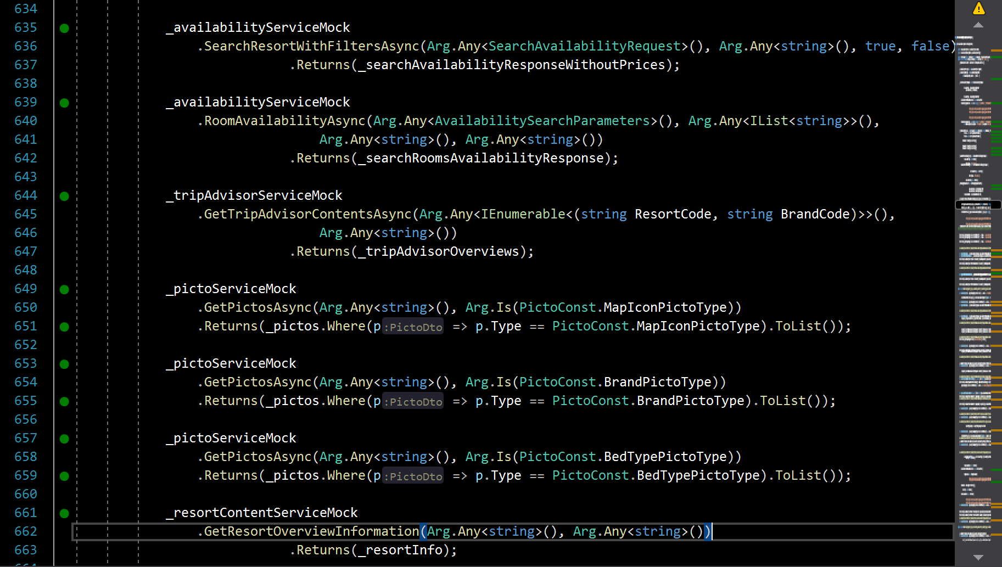
Test Driven
development
Test Suite for Rooms Availability
740 lines of Init()
3.
Beware of… Complex setups
THOMAS PIERRAIN (@TPIERRAIN)
Notes:
Image: https://insights-images.thoughtworks.com/1020ways20pair20programming201_ac7561ab53c005c72dd42a76dcc238a9.png

Slide 57
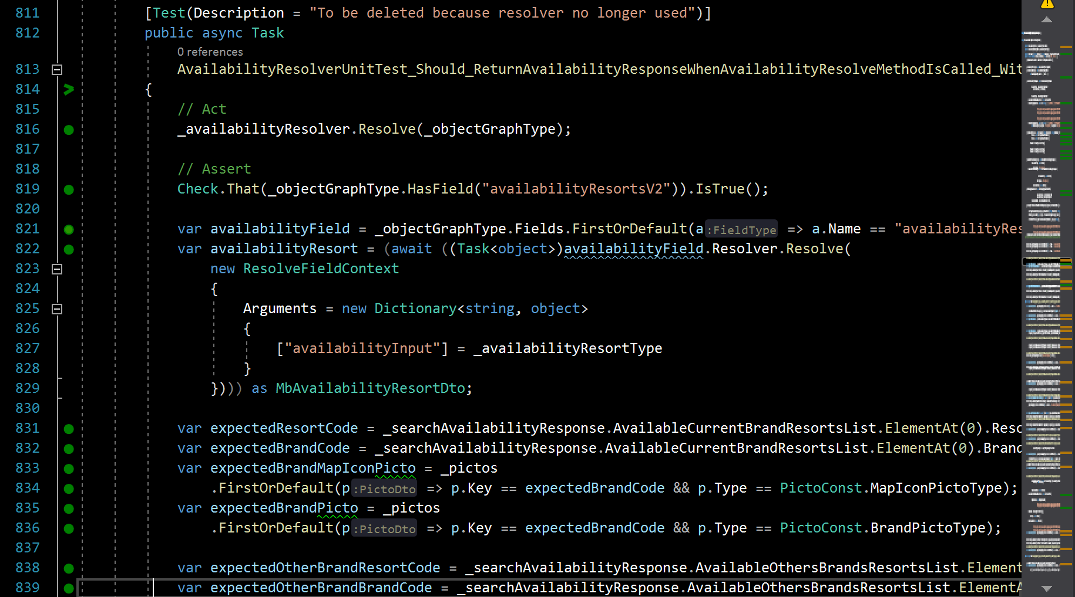

Test Driven
development
Test Suite for Rooms Availability
3.
Beware of… Complex setups
Tests using initialized fields ➔ side effects nightmare
THOMAS PIERRAIN (@TPIERRAIN)
Notes:
Image: https://insights-images.thoughtworks.com/1020ways20pair20programming201_ac7561ab53c005c72dd42a76dcc238a9.png

Slide 58

Test Driven
development
Mitigations
Avoid cognitive overload as much as possible (i.e. anything that is declared outside your test)
Favor local variables over test suite members Everything should be created from the test
Use Domain-Driven Builders to shorten and explicit the Arrange section of your tests
Treat your test code as production code! ➔ mercyless refactoring
3.
Beware of… Complex setups
THOMAS PIERRAIN (@TPIERRAIN)
Notes:
Do not use field members, [Init], [Setup] … anything that is declared outside the test
Do not use test suites inheritance neither
Arrange – Act - Assert
Image: https://insights-images.thoughtworks.com/1020ways20pair20programming201_ac7561ab53c005c72dd42a76dcc238a9.png

Slide 59
Test Driven
development
1. Fragile tests
2. Blind spots
3. Complex setups
Beware of…
THOMAS PIERRAIN (@TPIERRAIN)
Notes:
Cognitive overload reduce stamina ➔ Pit of failure. Like a broken window syndrome.
https://www.welcometothejungle.com/en/articles/cognitive-overload-at-work
Image : https://encrypted-tbn0.gstatic.com/images?q=tbn:ANd9GcRUkEI7a62LZWV7URYcN5jClByl0GkP6ReZvA&usqp=CAU
I could have added
Non deterministic
The team must be confident in their tests
Fragile tests / Painful Refactoring
Messy test code
Slowness
Non deterministic

Slide 60
Test Driven
development
When we test Implementations instead of behaviours ; - (
Because We tend to overlook some boring but crucial areas ( like adapters code )
1. Fragile tests
2. Blind spots
3. Complex setups
When ( Unit x Integration )
Test coverage is not enough
Beware of…
THOMAS PIERRAIN (@TPIERRAIN)
cognitive overload reduces stamina
and engagement
Notes:
Cognitive overload reduce stamina ➔ Pit of failure. Like a broken window syndrome.
https://www.welcometothejungle.com/en/articles/cognitive-overload-at-work
Image : https://encrypted-tbn0.gstatic.com/images?q=tbn:ANd9GcRUkEI7a62LZWV7URYcN5jClByl0GkP6ReZvA&usqp=CAU
I could have added
Non deterministic
The team must be confident in their tests
Fragile tests / Painful Refactoring
Messy test code
Slowness
Non deterministic

Slide 61
Test Driven
development
Do not test “implementation details”
Favor Acceptance tests (coarse-grained unit tests)
When we test Implementations instead of behaviours ; - (
Because We tend to overlook some boring but crucial areas ( like adapters code )
Include the Adapters to your Acceptance tests
Test the adaptation in action
(All corner cases covered)
Stub only the I/O
(super fast tests)
1. Fragile tests
2. Blind spots
3. Complex setups
When ( Unit x Integration )
Test coverage is not enough
Mitigations
Use Domain-Driven Builders to shorten and explicit the Arrange section of your tests
THOMAS PIERRAIN (@TPIERRAIN)
cognitive overload reduces stamina
and engagement
Notes:
Cognitive overload reduce stamina ➔ Pit of failure. Like a broken window syndrome.
https://www.welcometothejungle.com/en/articles/cognitive-overload-at-work
Image : https://encrypted-tbn0.gstatic.com/images?q=tbn:ANd9GcRUkEI7a62LZWV7URYcN5jClByl0GkP6ReZvA&usqp=CAU
I could have added
Non deterministic
The team must be confident in their tests
Fragile tests / Painful Refactoring
Messy test code
Slowness
Non deterministic

Slide 62
Outside-in Diamond TDD
Trade offs made in reaction to people’s behaviors
(observed around us over and over and over again)

Slide 63
Outside-in Diamond TDD
For the overall workflow we favor
For the kind of tests we favor the most

Slide 64

Test Driven
development
Double loop
One and a half loop
Outside-in but…
THOMAS PIERRAIN (@TPIERRAIN)

Slide 65
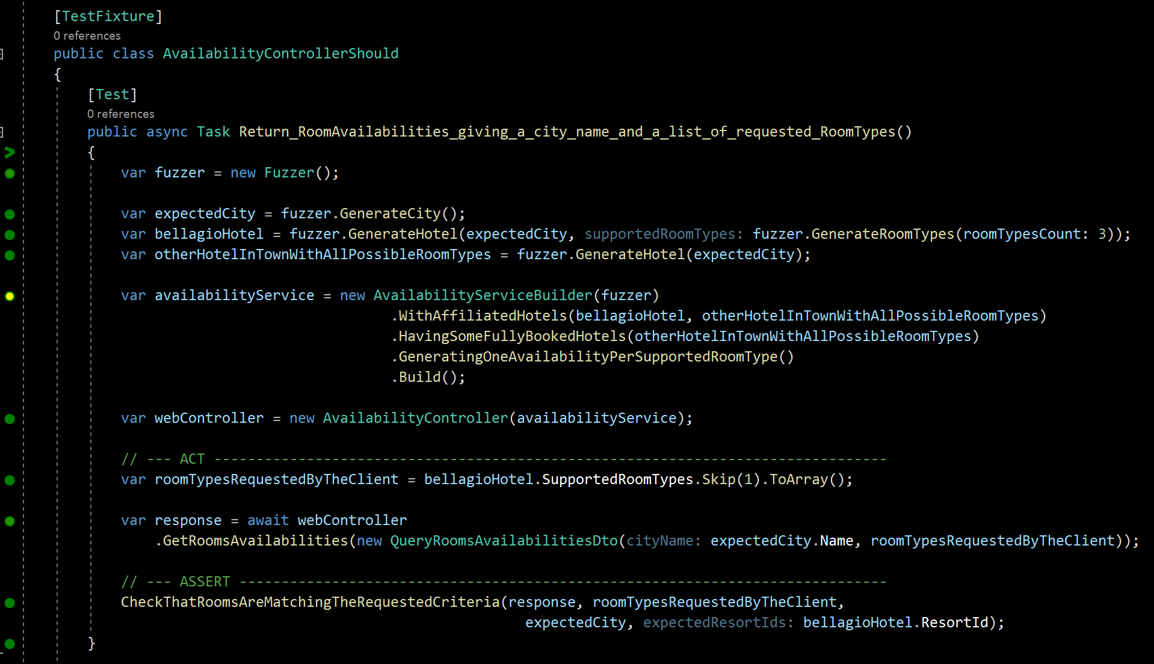
Outside-in diamond

Slide 66
Outside-in diamond

Slide 67
Outside-in diamond
+
Read it as a sentence divided into 2 parts

Slide 68
Outside-in diamond
Fuzzers help us - to randomly detect hard-coded values or unsupported case

Slide 69
Outside-in diamond
Fuzzers help us - to randomly detect hard-coded values or unsupported case
- to shorten our test setup
Notes:
For instance here in 1 line only, I can create a specification for an hotel, the Bellagio hotel, and specify the RoomTypes it must have (with my fuzzer.GenerateRoomTypes (allowing 3 room types to be picked randomnly from my domain)

Slide 70
Outside-in diamond
Builders allow Behavioral & Domain-Driven intentions (no tech details here)
Notes:
Then we use to rely on builders (see the builder pattern) in order to declare what we need to setup for this test.
These builders must be Domain-driven (in other words, they are using the ubiquitous language of our domain experts in order to express domain intentions only. Not technical)
How does it look like? Here, we want…

Slide 71
Outside-in diamond
Builders allow Behavioral & Domain-Driven intentions (no tech details here)
Notes:
To work with 2 affiliated hotels. I’m working for an international group having tons of hotels from various brands and policies etc.
The 2 hotels are described via the hotel specifications I’ve created just before with my fuzzer.

Slide 72
Outside-in diamond
Builders allow Behavioral & Domain-Driven intentions (no tech details here)
Notes:
Then I explain to my builder that I would like to have one fully-booked hotel (the one named “otherHotelInTownWithAllPossibleRoomTypes”).
Hence I will be able to check after, that no availability must be suggested from this fully booked hotel (we should only have availabilities from the Bellagio hotel)

Slide 73
Outside-in diamond
Builders allow Behavioral & Domain-Driven intentions (no tech details here)
Notes:
Then we ask our builder to setup all the stubs/test doubles/etc we need for this test so that we simulate a situation where we should have “1 availability per supported room type for every hotel”

Slide 74
Outside-in diamond
Builders allow Behavioral & Domain-Driven intentions (no tech details here)
Notes:
And finally we build our Availability service. The one that is doing the domain logic, the one hiding behind a left-side port (of our hexagonal architecture for instance).
The domain logic that we will inject to our web controller (in other word : our left-side adapter).

Slide 75
Outside-in diamond
Very important!
Builders allow Behavioral & Domain-Driven intentions (no tech details here)
Notes:
…Very important for both our future refactorings but also for the sake of readability:
We should never, ever, never put some technical details in our builder domain specific language. Only domain-driven intentions and expected behaviours.

Slide 76
Outside-in diamond
Injecting the result of our builder
We test from the left-side Adapter (here a web controller)
Notes:
Then we can instantiate our subject under test (the SUT), which is the AvailabilityController (web controller)
Doing so, tackling at the web controller level, it helps us to cover all its adapting code. And remember, we don’t test the network here! Only the adaptation code (from JSON, DTOs to domain one and vice versa when we need our API to return an answer)

Slide 77
Outside-in diamond
We define the end-user request
No I/O here, but we test the whole { black-box / component / API }
Notes:
We then define our end-user request. Here as a customer, I want to know what availability you will have for me and a bunch of room types (e.g.: Single room, double room, family suite etc)
And important here: no network, no I/O. Even if we want to test all the API, our component. We want our Acceptance tests to be as fast as possible.

Slide 78
Outside-in diamond
Helper method to sum-up in “one line” our assert intention
Notes:
Last but not least: the assertion.
Instead of exposing all the DTOs and checks on our technical / infra answers, we hide them behind a one-liner Domain-driven intention private test method.
The CheckThatRoomsAreMatchingTheRequestedCriteria private method of my test suite, my test fixture.

Slide 79
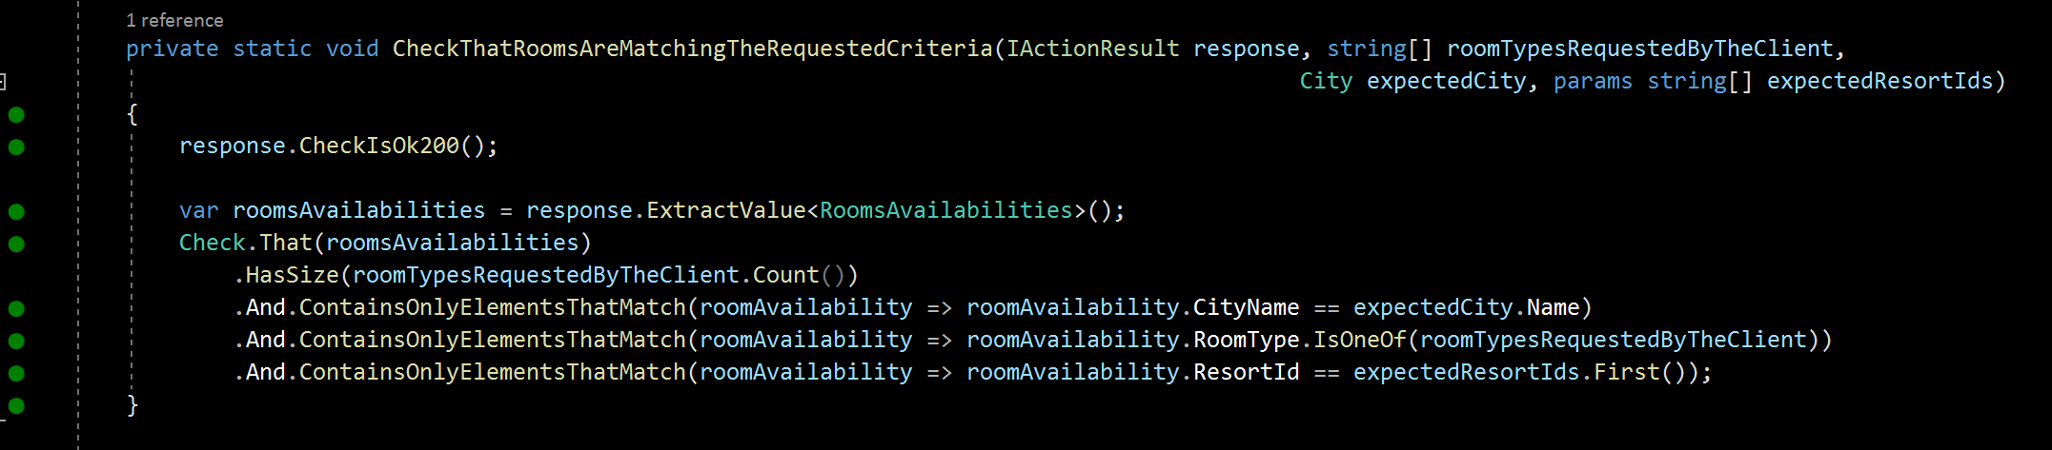
Outside-in diamond
“One line” to hide our technical assertions towards DTOs etc.
Notes:
One line in order to hide its implementation. To hide all its assertions/checks on the DTO returned by our web controller as the answer.

Slide 80
Outside-in diamond
“One line” to hide our technical assertions towards DTOs etc.
“One line” to reuse the same intention with various adapters
Notes:
Encapsulating infrastructure behind that private method has also a very interesting side-effect:
It allows us to reuse the very same assertion intention (expressed in the domain language), but to assert on different left-side adapters (if you have this requirement).
I mean: the requirement of having to switch the exposition models and technologies to expose your service either through a web API, a message-oriented middleware, etc. But on my side, we usually exposes our services through web APIs.
So. Once again, “encapsulate change” is a good advice.

Slide 81
Outside-in diamond
Notes:
Ok. To sum-up

Slide 82
Outside-in diamond
Notes:
First we have the Arrange part of the test. Should not take more than 8-10 lines

Slide 83
Outside-in diamond
Notes:
Then we have the ACT section of our test which is targeting left-side adapters (here a web controller).
Here: 2 lines
One can even hide the DTO declaration behind a single test private method that will do the job.
It can be really helpful for people having to test more than one left side adapter as we just mentioned in the previous slide.
So Action between 1 or 2 lines

Slide 84
Outside-in diamond
Notes:
And finally we have the Assert section of our Acceptance test.
Here: 1 line
And then here again, you can “eat your cake and have it too” (meaning: you can have a Domain-driven assertion without any specific details about your DTOs and infrastructure adaptations, but nonetheless testing them in order to avoid bugs in production related to any Adapter).
To do so, all you have to is to hide our assertions behind a private method that will express your assert intention. Here I could have found a better example of a domain-driven name... but I hope you can get my point.

Slide 85
Outside-in diamond
Notes:
Here is the full test

Slide 86
Outside-in diamond
Arrange
ACT
Assert
Notes:
With its 3 A-A-A sections highlighted :
ARRANGE – ACT - ASSERT

Slide 87
Outside-in diamond
Fuzzers to shorten & speed setup
Arrange
Builders to shorten and “domain-driven” our test setup
ACT
Assert
Notes:
And 2 things to remember: use fuzzers & builders
They will allow you to:
shorten your tests
speed up their writing
improve your bug detection
Make them less fragile, because less connected to your implementation
Foster Domain-driven expressivity

Slide 88
Live code

Slide 89
Wrap up

Slide 90




Checking In real life…
All real systems involved May be Manual sometimes
To this
QA
Smoke tests Exploratory tests End-to-end tests
From this
contract tests
Integration tests
Are we still compliant with…?
Some real systems involved
Ensure that Stubs ⬄ Real systems
It all starts here…
Outside-in TDD
Behavioural & Domain-Driven
Bloody Fast
Autonomous & Concise (builders & Fuzzers to setup)
NO I/O ➔ “last miles” stubs
Deterministic & Isolated
The outer loop
Start Here
Acceptance tests
(Coarse-grained “unit” tests)
unit tests
(Fine-grained)
For complex parts only
Behavioural & Domain-Driven
Bloody Fast
Deterministic & Isolated
The inner (optional) loop
testing gem: Why outside-in diamond is now our favorite testing strategy @

Slide 91
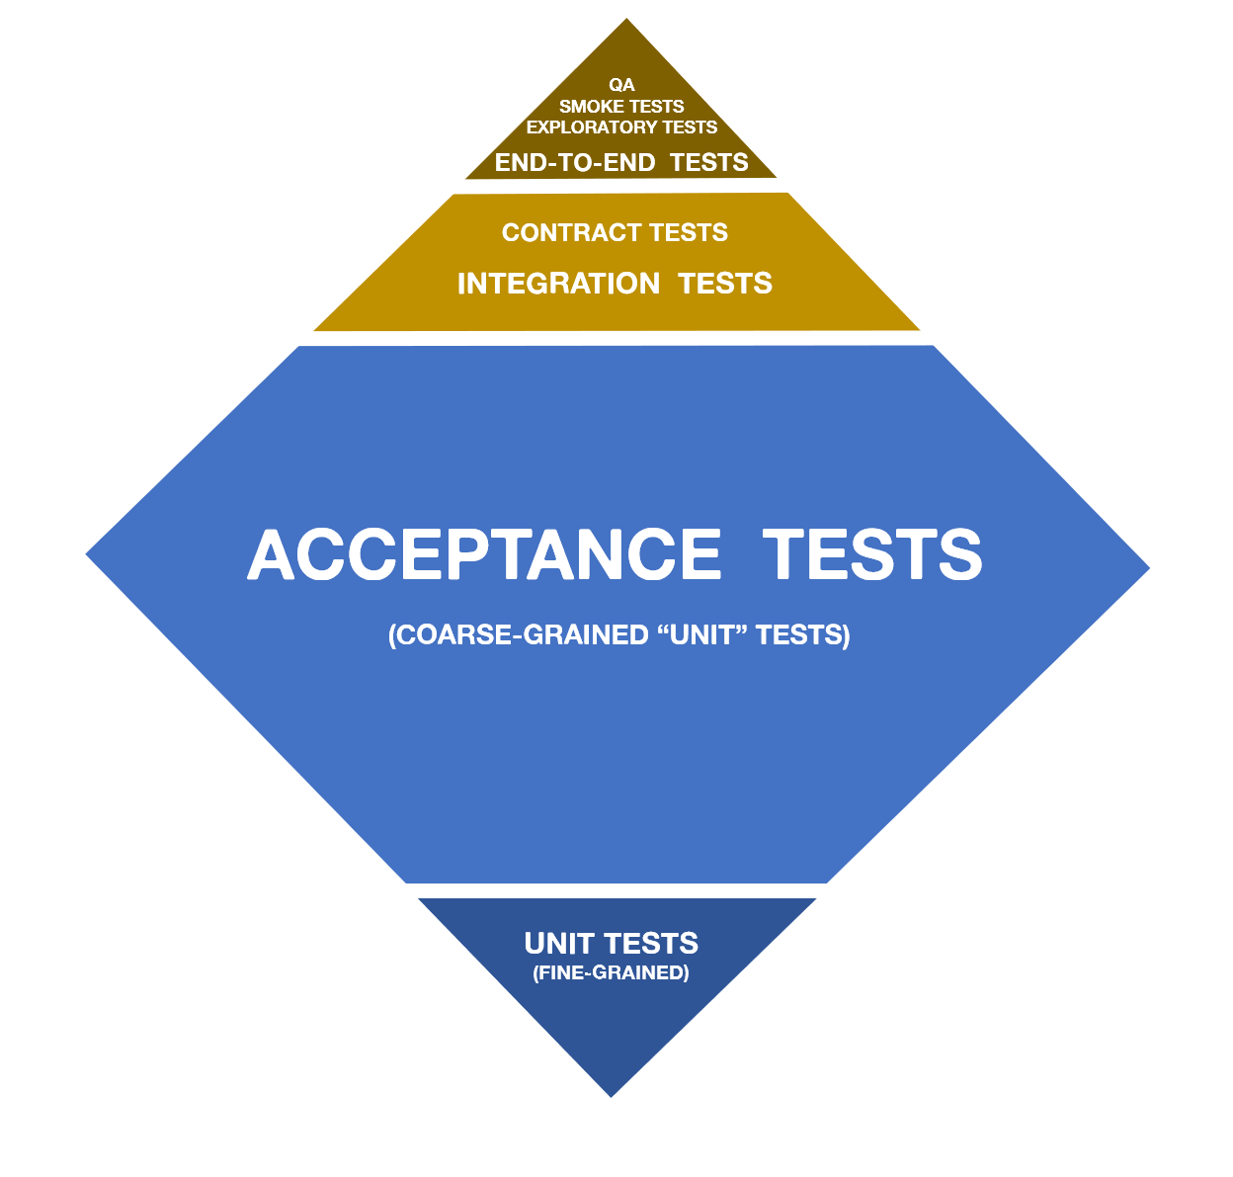
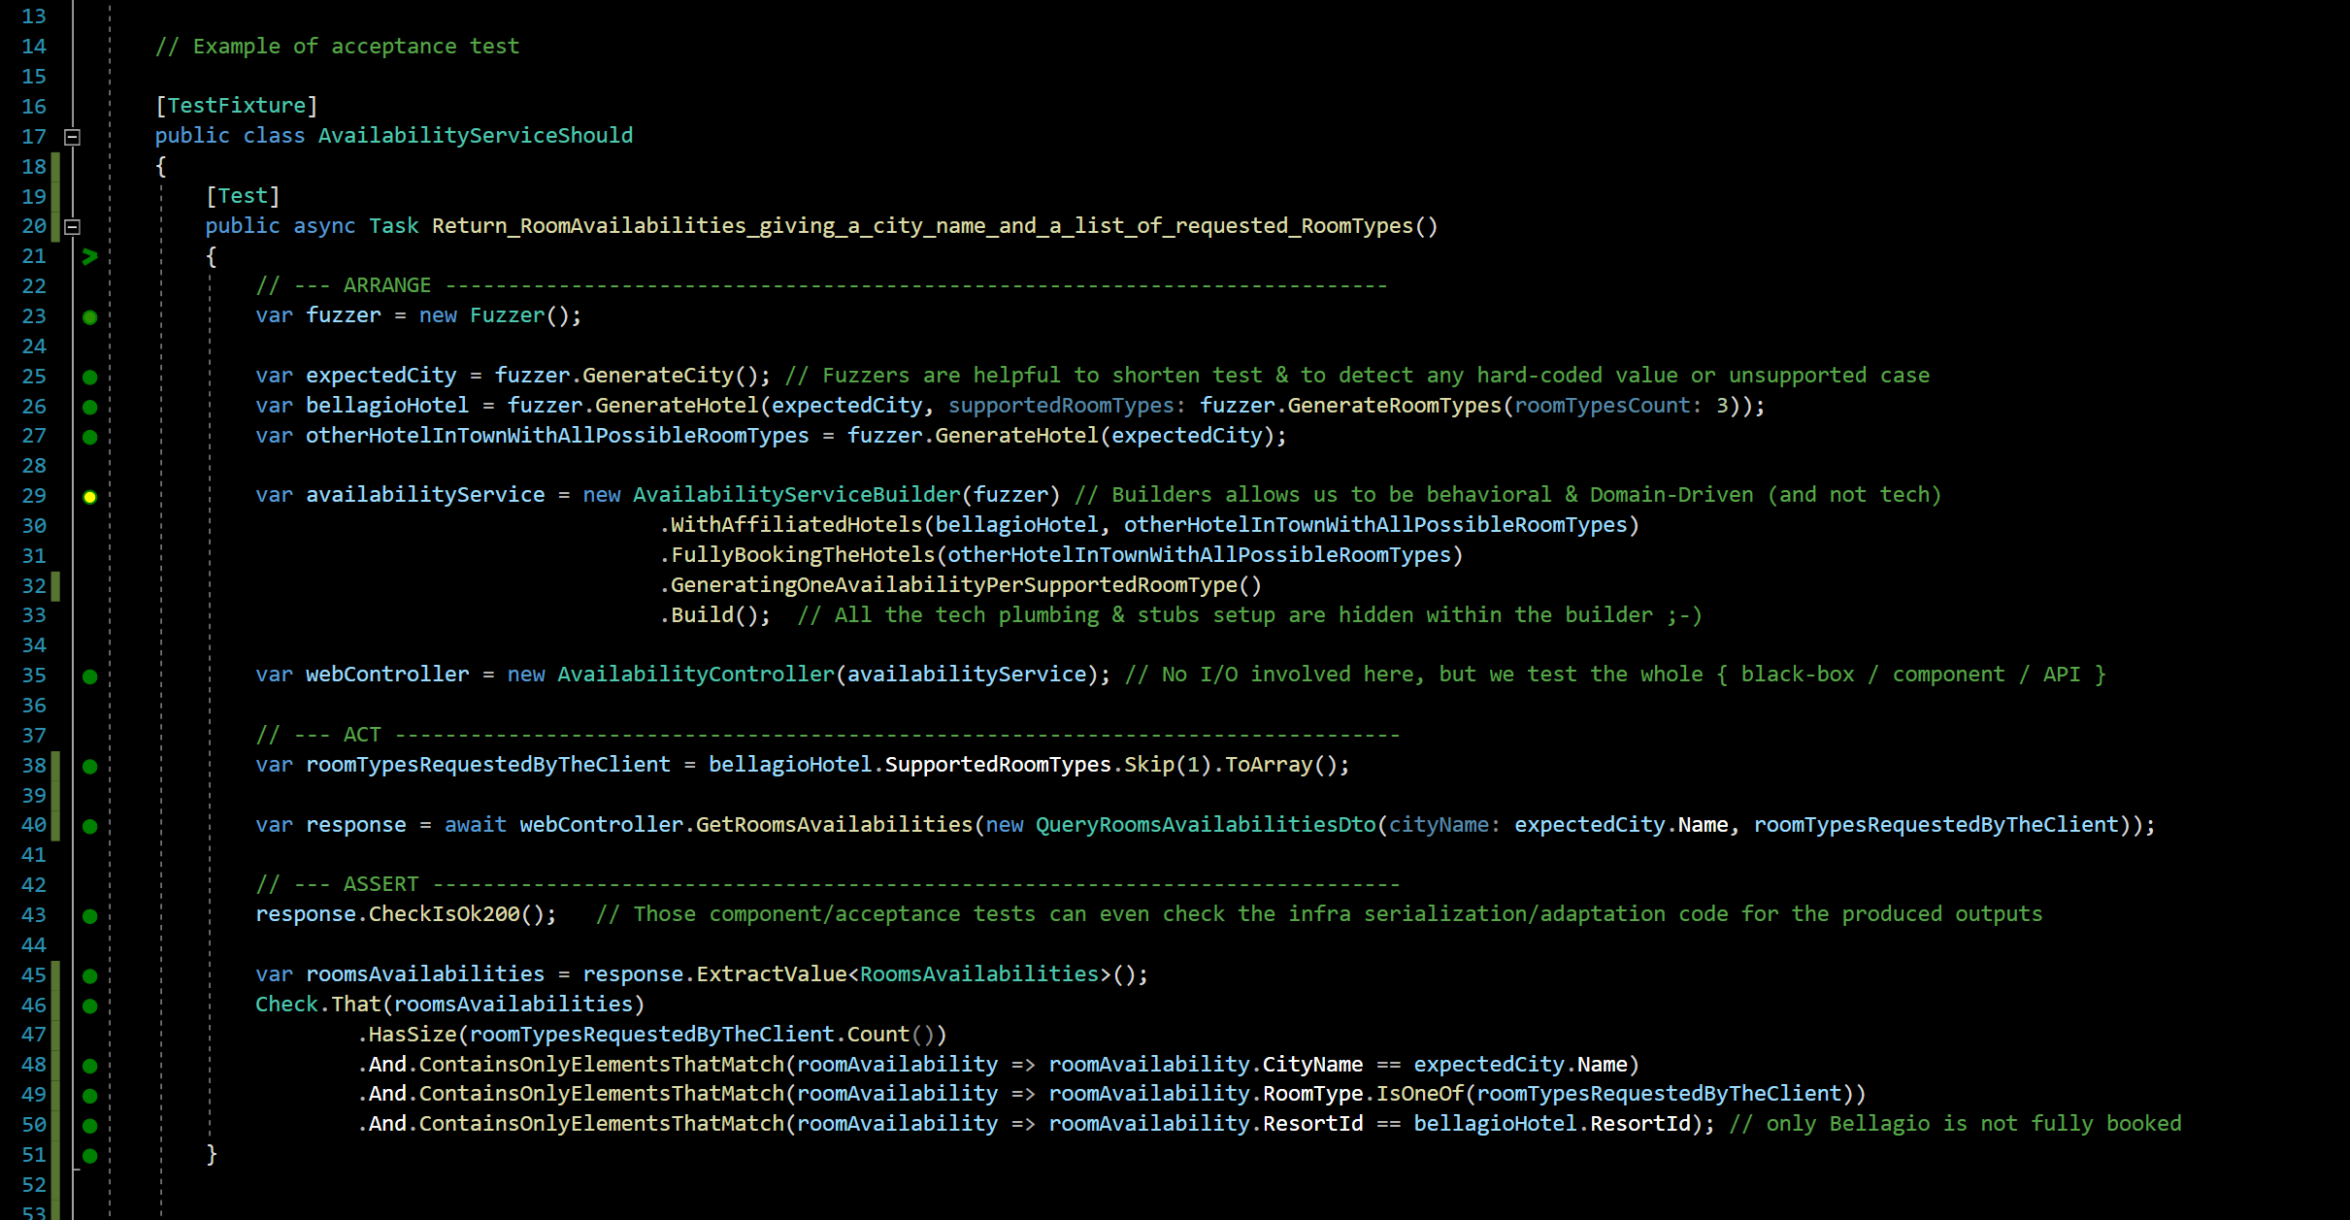
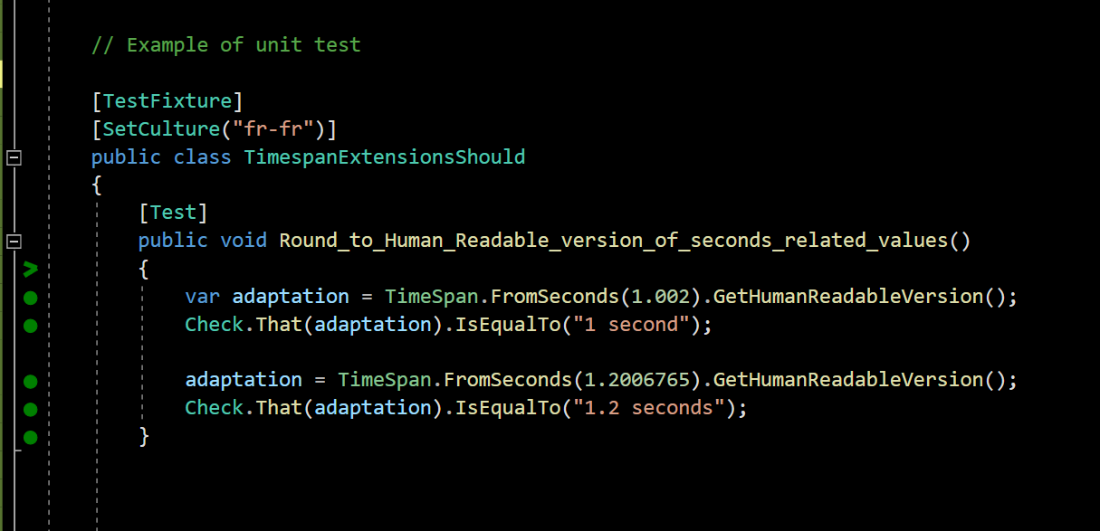
Can you Give me an example?
testing gem: Why outside-in diamond is now our favorite testing strategy @

Slide 92
What you test is what you ship…
No more bad surprises in situation >> everything is tested assembled
no more code plumbing leaks >> Our Acceptance tests cover everything (but I/O)
complementary contract (integration) tests >> A guarantee that the stubs we use to speed our Acceptance tests are faithful to reality
WHY
Easier for Junior DEVs
They are More focused on the system behaviors >> it Enforces Yagni
They code less fragile tests (no more implementation tests) >> it Eases merciless Refactoring
How
Specific Outside-in TDD
Double loop ➔ one and a half loop instead (Fine-grained unit tests only whenever facing difficulties)
Still Baby steps FTW!
only the external systems are stubbed
Acceptance tests cover adapters code too! (only the adaptation code in action, not its I/O)
Behavioural and domain-driven tests (DDD Ubiquitous language)
Blazing-fast acceptance tests
But…
…What about
Combinatory explosion of test cases?!? ➔lots of concise & easy to write acceptance tests (powered by fuzzers) were more than sufficient in 85% of our xp
Surgical identification of bug spots?!? ➔ no big deal actually. very episodically, You just debug your reproductible acceptance test and… TADA! (this point was just cargo-cult psychological barrier)
Friendly patterns & tools
DDD & Hexagonal architecture
Builders & Fuzzers for acceptance tests setup
live-testing tools
Dev people dislike to write enough integration tests (vs. unit ones). This explains lots of Blind Spots & Failures of classical test strategies
➔ We've tradeoff former approaches (UT x IT) in favor of safeness in production whatever the vigilance of the dev team
testing gem: Why outside-in diamond is now our favorite testing strategy @
Notes:
Blind spots of lots of test strategies is due to the fact that dev doesn’t take lot of time to code integration tests (vs. unit ones)
We trade off former approaches (UT x IT) in favor of quietness in production whatever the dev team.
Realizing that We realized that dev took more time to unit test than to integration tests
Dev dedicate a lot more times to unit test than integration tests

Slide 93
Binary is for machine Code is for people We care people
Special thanks to: Cyrille DUPUYDAUBY & Rui CARVALHO for their kind reviews & feedbacks

Slide 95
Test Driven
development
1. Fragile tests
2. Blind spots
3. Complex setups
Title here
THOMAS PIERRAIN (@TPIERRAIN)

Slide 96
Notes:
Image: https://miro.medium.com/max/7788/1*0aU36QSwzY0no7XEjoyM7g.jpeg

Slide 97
Notes:
Image: https://insights-images.thoughtworks.com/1020ways20pair20programming201_ac7561ab53c005c72dd42a76dcc238a9.png

Slide 98
Outside-in?
Test Driven
development
AT
AT
UT
UT
AT
AT
API
AT
UT
THOMAS PIERRAIN (@TPIERRAIN)
UT
Notes:
Image: https://miro.medium.com/max/13440/1*o7WmwGkLVR0dVQUYqfSBeg.jpeg

Slide 99
Test Driven
development
AT
AT
AT
AT
AT
AT
AT
AT
AT
AT
AT
AT
Domain
AT
AT
AT
100% covered
by Acceptance Tests
2.
Beware of… Blind Spots
Stub
BUG
IT
Right Adapter
Because integration tests are slow & boring ➔
IT
80%
IT
BUG
IT
THOMAS PIERRAIN (@TPIERRAIN)
HTTP
Left Adapter
80%
IT
API
IT
BUG
IT
Notes:
Image : https://insights-images.thoughtworks.com/pairprogramming_f0d3ae7ef121e981e150bfcae4ecb995.jpg

